Slide 1
CASCADE NextGen Test Framework
An Online Test Engine

Slide 2
Architecture
L2/L3/L4/L6
Server(s)
ELK/My SQL
Magic Services
TCs Request/Response
Source
Data Files
Master Keyword File
Tomcat Server
Automation Test Engine
Online Test
Data / Exec Controller
Results Dashboard

Slide 3
Flow
Test Engine UI
Automation Test Engine for Services & Data Quality
Services Test
Data Validation
Data Quality Test using Pyhton Web service
Setup
Configure Services & Level
Results Dashboard
Execute Accuracy/Benchmark test in one go
Load Test Cases in ELK index
Centralized Data file path
Integration with CI/CD

Slide 4
Benefits
Single Test Automation tool for Services, Accuracy(Benchmark) and Data Validation
Easy integration & configurable with Jenkins for deployment pipeline in comparison to LISA.
Optimized execution with 60-70% faster results time compared to LISA
Dashboard view for execution results.
No Limitations for test case size (TCs limited to 2MB only using LISA)
Accessibility for test execution by anyone.
“Easy integration & Configurable …” point not clear to me, need more details – Ashutosh D
“Optimized execution…” point not clear to me, need more details – Ashutosh D
Please provide more details on actual content we need to show on the dashboard view – Ashutosh D
Not clear to me, please provide more details – Ashutosh D

Slide 5
System Requirements
Windows Server
16 GB RAM
150 GB Hard Drive
Tools -
Elastic Search/MySQL
Eclipse Latest
Java JDK 1.8
Node.js
npm
Technologies stack -
HTML5
Bootstrap3
Angular JS 2
Java 1.8
Spring boot
Hibernate/JPA
Should the system requirement affect the performance of this application/ tool ? I assume that this will be verified automatically for compatibility, please confirm!– Ashutosh D

Slide 6
BigData
Pull to data from Oracle and push it to datalake (HDFS)
Analytics
ELK
Ingesting and creating the MKL file in HDFS
Generate Comparison Report
Refninary-optimization -processing--> Hive
Create tsv for downstream system
Generate Validation Report
Execution & Report generation for Qualitative & Quantitative analysis.
IF all validations passed, then index the file ELSE do not index.
Trigger status mail with the report.

Slide 7
Appendix

Slide 8
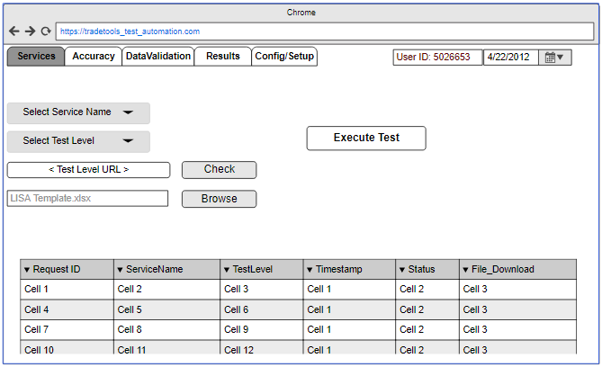
Test Engine - Services
What are the services to be choose here?
How the Calendar functionality is used here?
Do we need login, help, account details screen as well? – Ashutosh D
Need more details on this function
We assume that this table data will be populated after the test is executed!
What is File_Download here?
Need to understand how users consumes this data

Slide 9
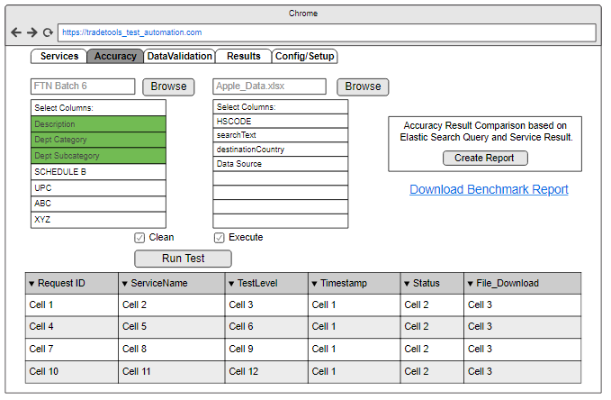
Test Engine - Benchmark/Accuracy
Need to understand how the Accuracy functionality works
What Clean means here?
What types of reports are created, who consume these reports, what action needs to be take based on these reports, are these saved in account and available later?
How Execute works?

Slide 10
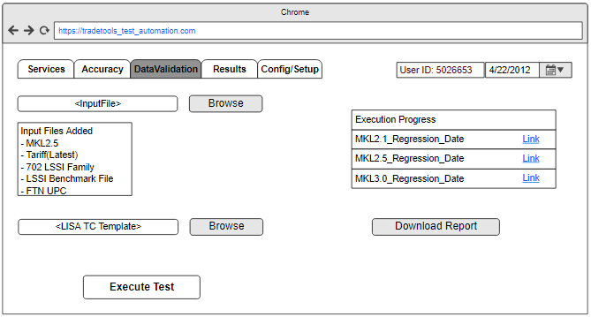
Test Engine – Data Validation
Need a functionally brief for
Data Validation
Are all files executed together, or one by one? How do we remove a selected file from this field?

Slide 11
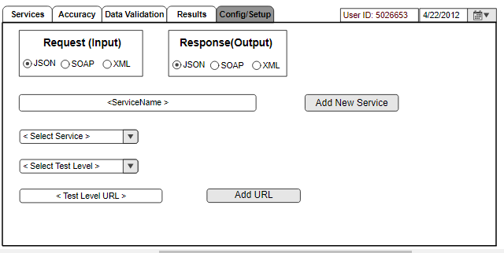
Test Engine – Configuration/Setup

Slide 12
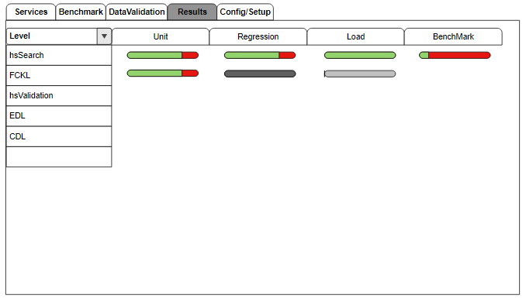
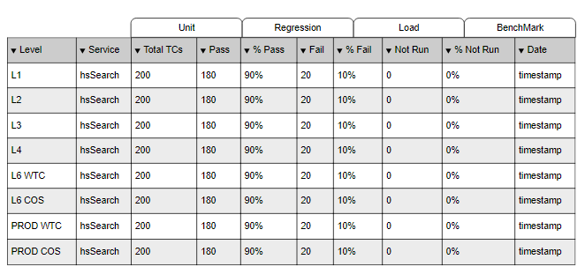
Results Dashboard UI
Need to understand how users consumes this data
Need to understand how users consumes this data

